Slide 1
Using Voltage Regulators to Power Your Projects
Bret Stateham
Bret.Stateham@microsoft.com
@BretStateham
http://channel9.msdn.com/niners/BretStateham

Slide 2
Agenda

Slide 3
What is a voltage regulator?
A Voltage Regulator is a component in a system that is designed to maintain or “regulate” a constant output voltage given certain parameters.

Slide 4
SO WHAT?

Slide 5
UNREGULATED POWER SUPPLIES THAT’S WHAT!

Slide 6
OH, AND PROJECTS WITH MULTIPLE VOLTAGE AND POWER REQUIREMENTS TOO!

Slide 7
SO THERE!

Slide 9
Step-Down AC Transformer
Primary Coil – Has more windings
AC Output voltage will be lower than AC Input voltage because the secondary coil has fewer windings.
AC INPUT
AC OUTPUT
Secondary Coil – Has fewer windings

Slide 10
AC-DC full wave Bridge rectifier
+V
AC INPUT
DC OUPUT
0V

Slide 11
AC-DC full wave Bridge rectifier
+V
AC INPUT
DC OUPUT
0V

Slide 12
AC-DC full wave Bridge rectifier
+V
+V
+V
AC INPUT
0V
DC OUPUT
+V
0V
0V
AC
DC

Slide 13
AC-DC full wave Bridge rectifier
+V
+V
+V
AC INPUT
0V
DC OUPUT
0V
0V
AC

Slide 14
AC-DC full wave Bridge rectifier
+V
+V
+V
AC INPUT
0V
DC OUPUT
0V
0V
AC

Slide 15
AC-DC full wave Bridge rectifier
+V
+V
+V
AC INPUT
0V
DC OUPUT
+V
0V
0V
AC

Slide 16
AC-DC full wave Bridge rectifier
+V
+V
+V
AC INPUT
0V
DC OUPUT
0V
0V
AC
DC

Slide 17
AC-DC full wave Bridge rectifier
0V
+V
AC INPUT
0V
DC OUPUT
+V
+V
0V
AC
DC

Slide 18
AC-DC full wave Bridge rectifier
0V
+V
AC INPUT
0V
DC OUPUT
+V
+V
0V
AC
DC

Slide 19
AC-DC full wave Bridge rectifier
0V
+V
AC INPUT
0V
DC OUPUT
+V
+V
0V
AC
DC

Slide 20
AC-DC full wave Bridge rectifier
+V
AC INPUT
DC OUPUT
0V
AC
DC

Slide 21
AC-DC full wave Bridge rectifier
+V
AC INPUT
DC OUPUT
0V
“BUMPY” OUPUT
AC
DC

Slide 22
AC-DC full wave Bridge rectifier
+V
AC INPUT
DC OUPUT
0V
DC AVG
AC
DC

Slide 23
Unregulated power supply
AC-DC Power Supply Input: 120VAC Output: 12VDC / 600ma

Slide 24
Unregulated power supply

Slide 25
VOLTAGE REGULATOR

Slide 26
IoT Logo

Slide 27
arduino

Slide 28
GALILEO BOARD

Slide 29
RASPBERRY PI

Slide 30
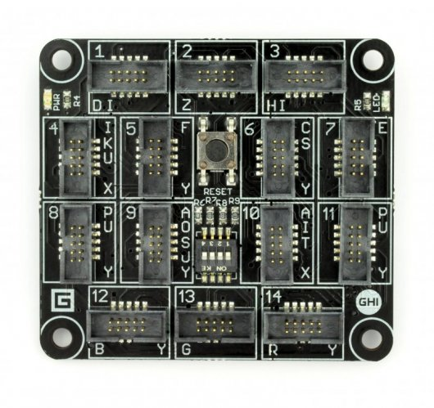
FEZ SPIDER MAIN BOARD

Slide 31
Sparkfun weather shield

Slide 32
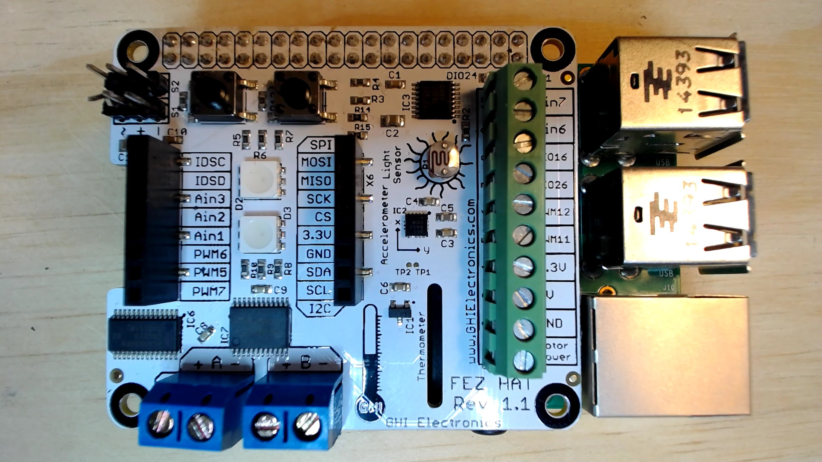
FEZ HAT

Slide 33
Connect the dots azure icons
Event Hubs
Stream Analytics
Storage
(
Azure
Microsoft Azure
Web App
Service Bus
)
Storage blob
Storage table
SQL database
HDInsight
Machine
(
Learning
GitHub code
Git repository
generic
)

Slide 34
LEDs

Slide 35
Resistors
220Ω
1st Digit
2nd Digit
Multiplier
Tolerance
Color | Name | 1st Digit | 2nd Digit | Multiplier | Tolerance
 | Black | 0 | 0 | X1
 | Brown | 1 | 1 | X10 | 1%
 | Red | 2 | 2 | X100
 | Orange | 3 | 3 | X1,000
 | Yellow | 4 | 4 | X10,000
 | Green | 5 | 5 | X100,000
 | Blue | 6 | 6 | X1,000,000
 | Violet | 7 | 7
 | Grey | 8 | 8
 | White | 9 | 9
 | Gold |  |  | X0.1 | 5%
 | Silver |  |  | X0.01 | 10%
330Ω
10KΩ

Slide 36
cables

Slide 37
More cables and adapters

Slide 38

LEDs
Anode (+)
Cathode (-)
Flat Edge
Small Post
Big Post
Long Leg
Short Leg
Vcc (+)
GND

Slide 39
LEDs

Slide 40
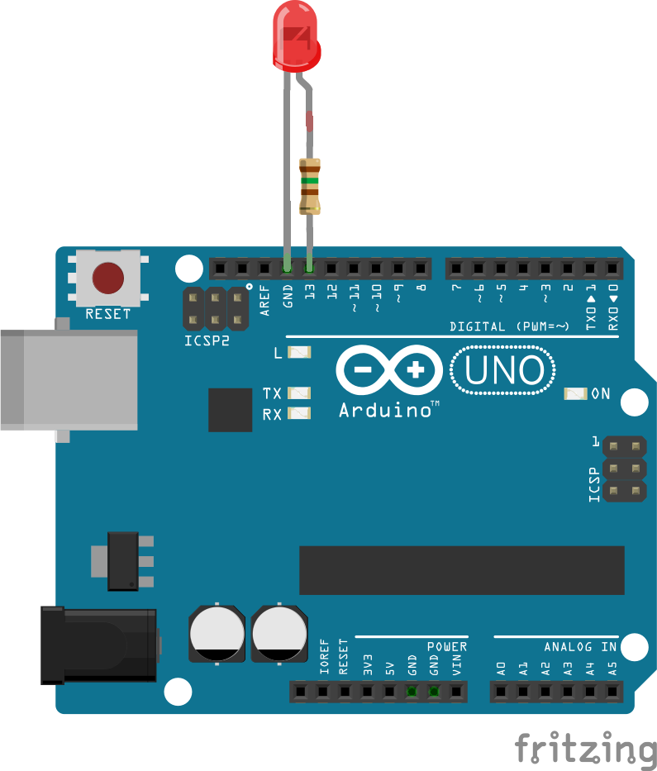


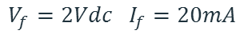
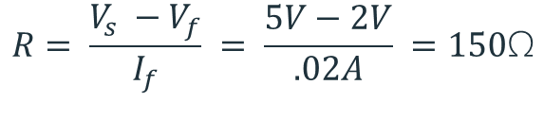
Current limiting resistors
Providing more current than an LED is rated for can destroy the LED. To prevent that, you should use a “Current Limiting” resistor.
To calculate the value of the resistor you need to know the supply voltage (Usually 5V on the Arduino Uno), and the LEDs rated Forward Voltage (the voltage drop across the LED) and Forward Current (the maximum current the LED can handle).
$$V_{f}=2Vdc I_{f}=20mA$$
$$Resistor Value (R)= \frac{Supply Voltage \left(V_{s}\right)−LED Forward Voltage (V_{f}) }{LED Forward Current (I_{f})}$$
$$V_{s}=5Vdc$$
$$R= \frac{V_{s} −V_{f}}{I_{f}} = \frac{5V−2V}{.02A} =150\text{Ω}$$
The Arduino Uno has a built in current limiting resistor on Pin 13. If you use Pin 13 to power your LED you can use it without a separate resistor.

Slide 41
Resistors
220Ω
1st Digit
2nd Digit
Multiplier
Tolerance
Color | Name | 1st Digit | 2nd Digit | Multiplier | Tolerance
 | Black | 0 | 0 | X1
 | Brown | 1 | 1 | X10 | 1%
 | Red | 2 | 2 | X100
 | Orange | 3 | 3 | X1,000
 | Yellow | 4 | 4 | X10,000
 | Green | 5 | 5 | X100,000
 | Blue | 6 | 6 | X1,000,000
 | Violet | 7 | 7
 | Grey | 8 | 8
 | White | 9 | 9
 | Gold |  |  | X0.1 | 5%
 | Silver |  |  | X0.01 | 10%
330Ω
10KΩ

Slide 42
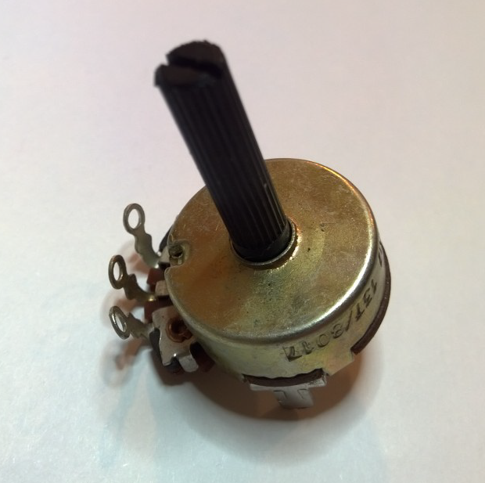
Potentiometer – variable resistor

Slide 43
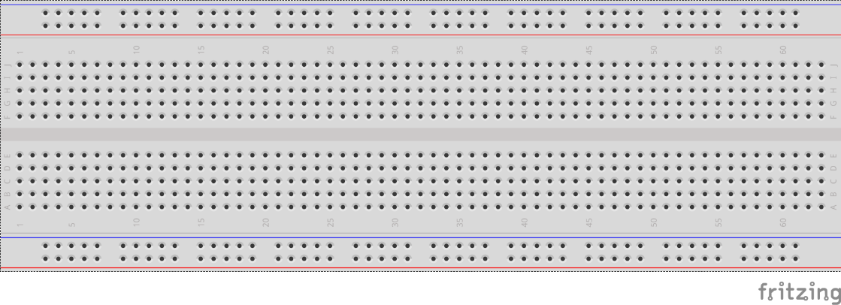
breadboards
Breadboards offer a great way to prototype circuits. The provide a number of “buses” for connecting both power and components.
Power buses run the entire horizontal length
Component buses give you easy ways to connect pins together

Slide 46
Micro SD Cards
Font: Segoe UI Semibold

